Slide 1
Linear Model
Ying Shen
Sse, tongji university
Sep. 2016

Slide 2
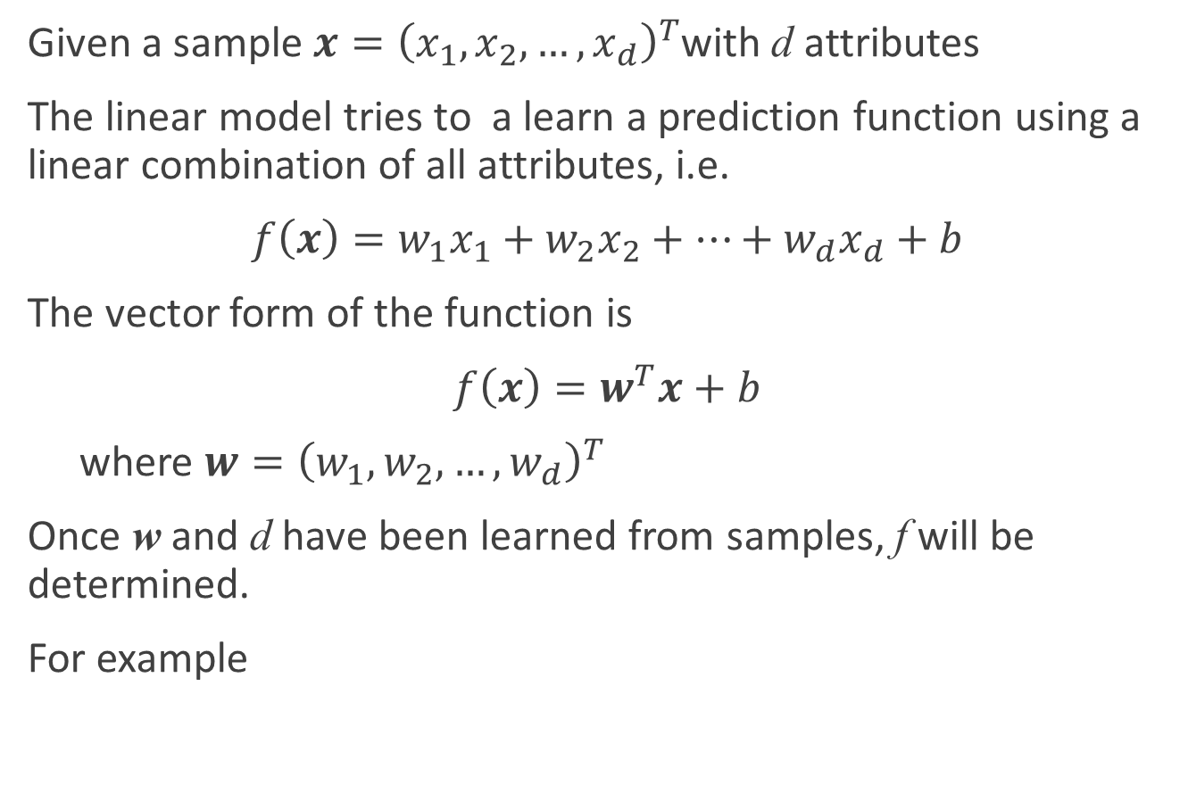
The basic form of the linear model
Given a sample $x={\left(x_{1}, x_{2}, …,x_{d}\right)}^{T}$with d attributes
The linear model tries to a learn a prediction function using a linear combination of all attributes, i.e.
$f\left(x\right)=w_{1}x_{1}+w_{2}x_{2}+…+w_{d}x_{d}+b$
The vector form of the function is
$f\left(x\right)=w^{T}x+b$
where $w={\left(w_{1},w_{2},…,w_{d}\right)}^{T}$
Once w and d have been learned from samples, f will be determined.
For example
$$f_{好瓜}=0.2∗x_{色泽}+0.5∗x_{根蒂}+0.3∗x_{敲声}+1$$

Slide 3
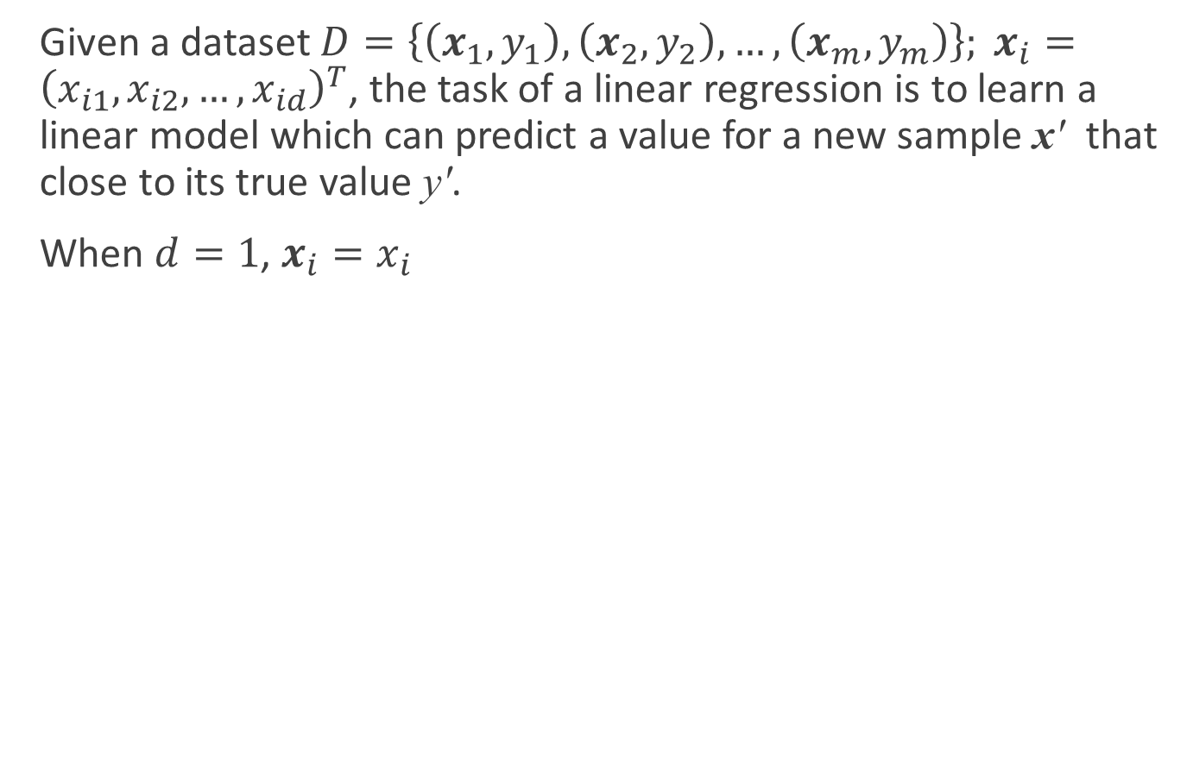
Linear regression
Given a dataset $D=\left\{\left(x_{1},y_{1}\right),\left(x_{2},y_{2}\right),…,\left(x_{m},y_{m}\right)\right\}; x_{i}={\left(x_{i1},x_{i2},…,x_{id}\right)}^{T}$, the task of a linear regression is to learn a linear model which can predict a value for a new sample x' that close to its true value y'.
When $d=1$, $x_{i}=x_{i}$
Hours Spent Studying | 4 | 9 | 10 | 14 | 4 | 7 | 12 | 22 | 1 | 3 | 8
Math SAT Score | 390 | 580 | 650 | 730 | 410 | 530 | 600 | 790 | 350 | 400 | 590

Slide 4

Linear regression
We will learn a linear regression model
$f\left(x_{i}\right)=wx_{i}+b, such that f(x_{i})≅y_{i}$
How do we determine w and b?

Slide 5
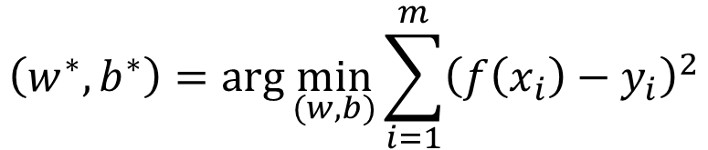
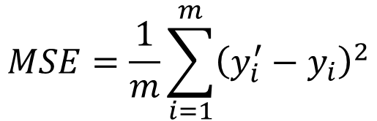
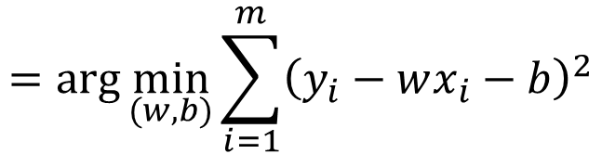
Linear regression
Mean squared error (MSE) is a commonly used performance measure:
We want to minimize MSE between f(x_{i}) and y_{i}:
$$MSE=\frac{1}{m}\sum_{i=1}^{m}{{\left(y_{i}^{′}−y_{i}\right)}^{2}}$$
$$\left(w^{∗},b^{∗}\right)=\arg{\min_{(w,b)}{\sum_{i=1}^{m}{{\left(f\left(x_{i}\right)−y_{i}\right)}^{2}}}}$$
$$=\arg{\min_{(w,b)}{\sum_{i=1}^{m}{{\left(y_{i}−wx_{i}−b\right)}^{2}}}}$$

Slide 6
Linear regression
The method of determining the fitting model based on MSE is called the least square method
In linear regression problem, the least square method aims to find a line such that the sum of distances of all the samples to it is the smallest.

Slide 7
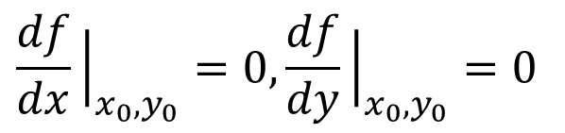

Pre-requisite
A stationary point of a differentiable function of one variable is a point of the domain of the function where the derivative is zero
Single-variable function:
f(x) is differentiable in (a, b). At x₀,
Two-variables function:
f(x, y) is differentiable in its domain. At (x₀, y₀),
$$\frac{df}{dx}{\left.​\right|}_{x_{0}}=0$$
$$\frac{df}{dx}{\left.​\right|}_{x_{0},y_{0}}=0,\frac{df}{dy}{\left.​\right|}_{x_{0},y_{0}}=0$$

Slide 8
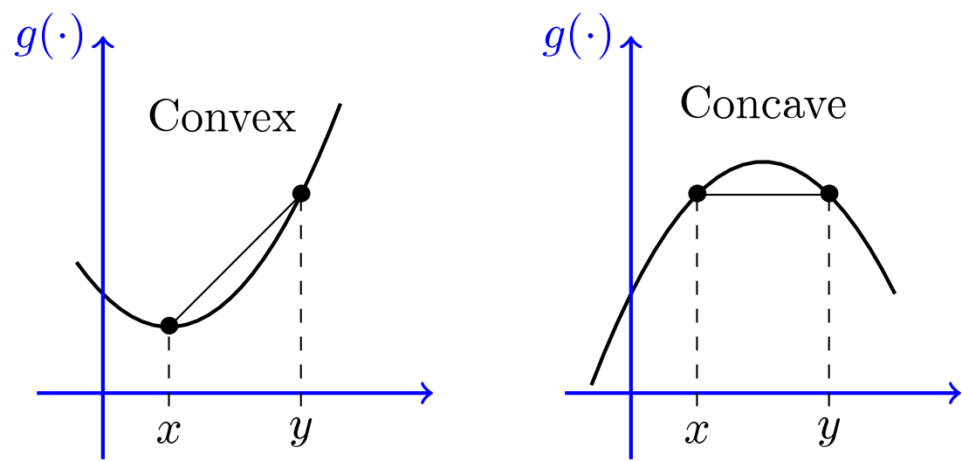
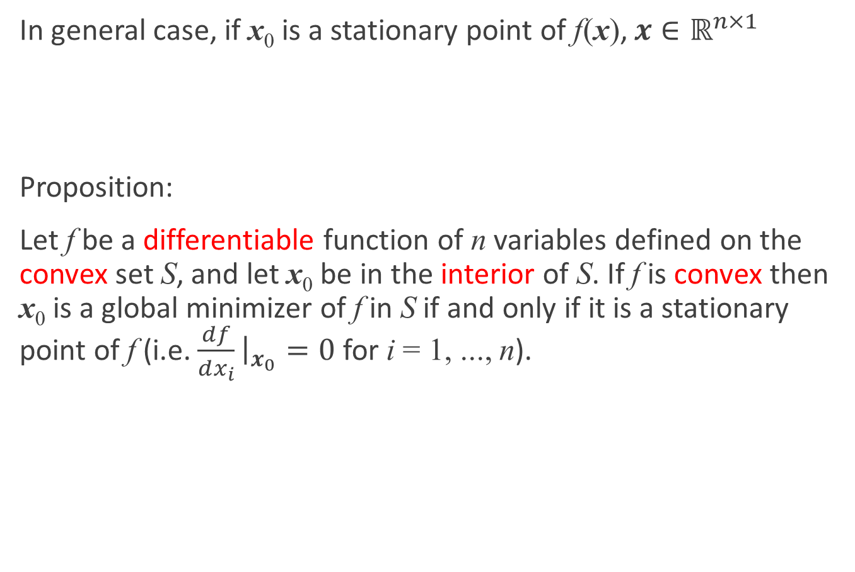
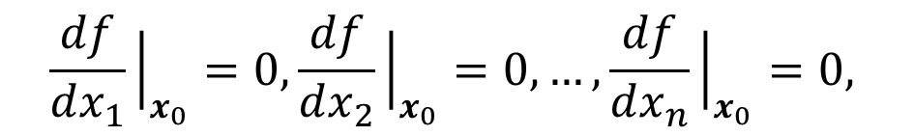
Pre-requisite
In general case, if x₀ is a stationary point of f(x), $x∈ℝ^{n×1}$
Proposition:
Let f be a differentiable function of n variables defined on the convex set S, and let x₀ be in the interior of S. If f is convex then x₀ is a global minimizer of f in S if and only if it is a stationary point of f (i.e. $\frac{df}{dx_{i}}{\left.​\right|}_{x_{0}}=0$ for i = 1, ..., n).
$$\frac{df}{dx_{1}}{\left.​\right|}_{x_{0}}=0,\frac{df}{dx_{2}}{\left.​\right|}_{x_{0}}=0,…,\frac{df}{dx_{n}}{\left.​\right|}_{x_{0}}=0,$$
Notes:
令S是实数上的向量空间，或者更一般地，是在某个有序域上，如果对于C中的所有x和y，并且在区间（0,1）中的所有t，点(1-t)x+ty 也属于C，则S中的集合C被称为凸。换句话说，连接x和y的线段上的每个点都在C中。
凸函数：设f为定义在区间l上的函数，若对l上的任意两点x₁、x₂和任意的实数λ∈(0,1)总有$f\left(λx1+\left(1−λ\right)x2\right)≤λf\left(x1\right)+\left(1−λ\right)f(x_{2})$

Slide 9

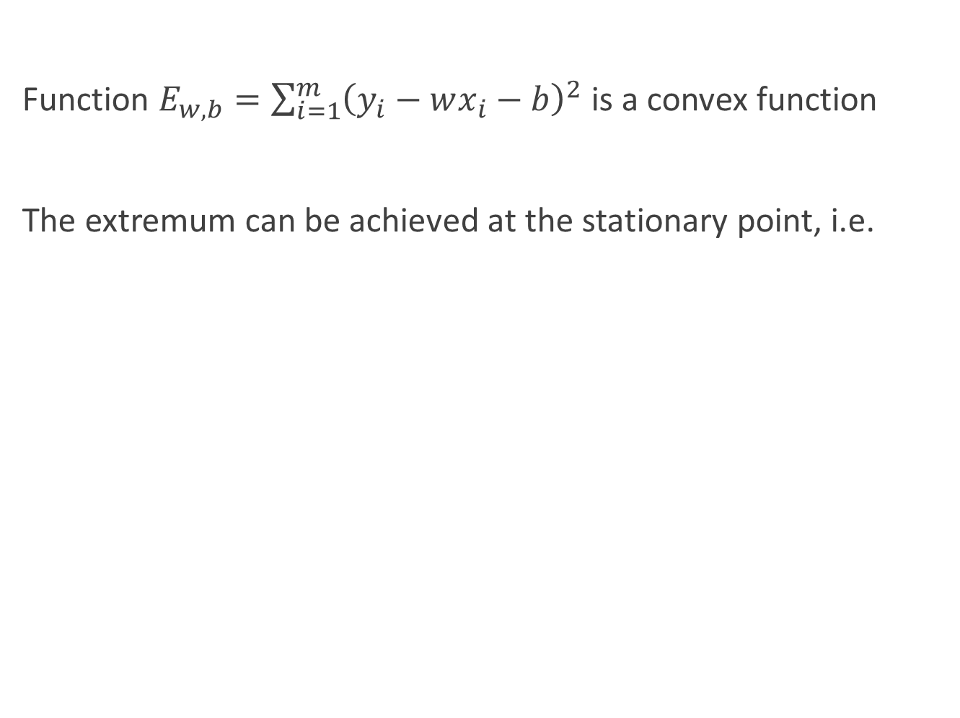

Parameter estimation
Function $E_{w,b}=\sum_{i=1}^{m}{{\left(y_{i}−wx_{i}−b\right)}^{2}}$ is a convex function
The extremum can be achieved at the stationary point, i.e.
$$\frac{∂E}{∂w}=2\left(w\sum_{i=1}^{m}{x_{i}^{2}}−\sum_{i=1}^{m}{\left(y_{i}−b\right)x_{i}}\right),$$
$$\frac{∂E}{∂b}=2\left(mb−\sum_{i=1}^{m}{\left(y_{i}−wx_{i}\right)}\right)$$
$$\frac{∂E}{∂w}=0,\frac{∂E}{∂b}=0$$

Slide 10
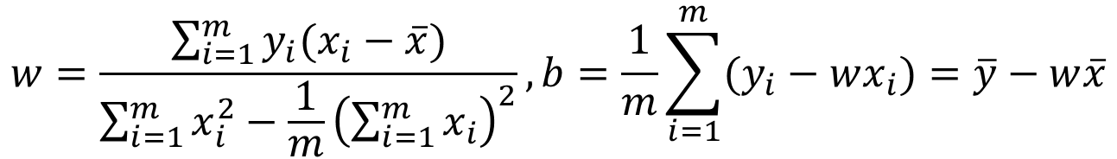

Parameter estimation
Solve the equations and we can have closed-form expression of w and b
Where $\overline{x}=\frac{1}{m}\sum_{i=1}^{m}{x_{i}},\overline{y}=\frac{1}{m}\sum_{i=1}^{m}{y_{i}}$ is the mean of x and y
$$w=\frac{\sum_{i=1}^{m}{y_{i}(x_{i}−\overline{x})}}{\sum_{i=1}^{m}{x_{i}^{2}}−\frac{1}{m}{\left(\sum_{i=1}^{m}{x_{i}}\right)}^{2}}, b=\frac{1}{m}\sum_{i=1}^{m}{(y_{i}−wx_{i})}=\overline{y}−w\overline{x}$$

Slide 11

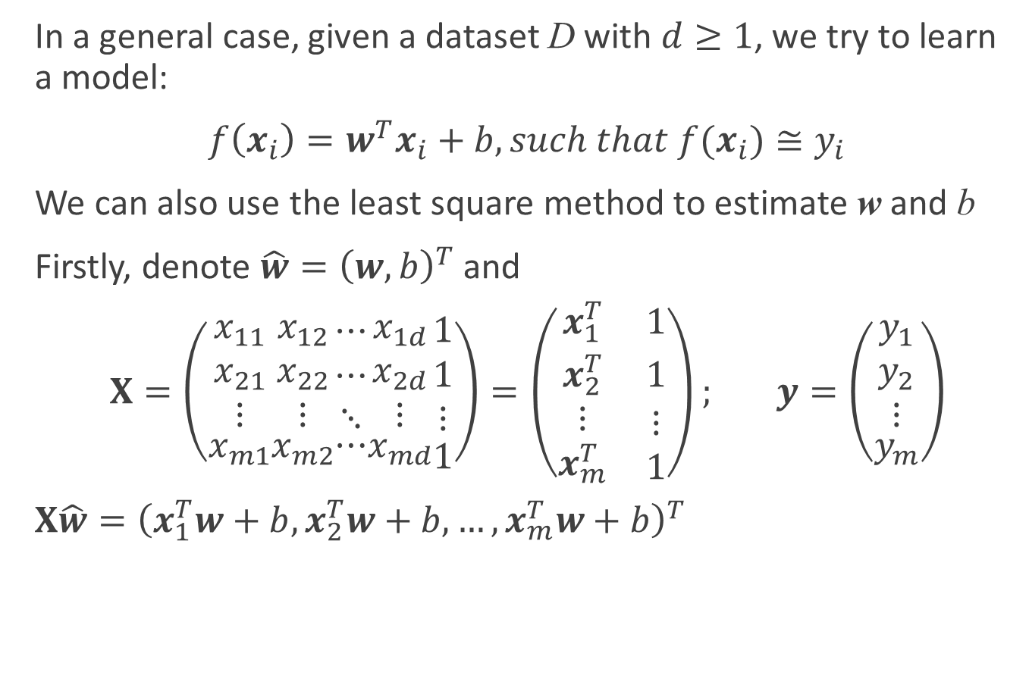
Multivariate linear regression
In a general case, given a dataset D with $d≥1$, we try to learn a model:
$f\left(x_{i}\right)=w^{T}x_{i}+b, such that f(x_{i})≅y_{i}$
We can also use the least square method to estimate w and b
Firstly, denote $\hat{w}={\left(w,b\right)}^{T}$ and
$X=\left(\begin{aligned}\begin{matrix}x_{11} \\ x_{21} \\ ⋮\end{matrix} \\ x_{m1}\end{aligned}\begin{aligned}\begin{matrix}x_{12} \\ x_{22} \\ ⋮\end{matrix} \\ x_{m2}\end{aligned}\begin{aligned}\begin{matrix}⋯ \\ ⋯ \\ ⋱\end{matrix} \\ ⋯\end{aligned}\begin{aligned}\begin{matrix}x_{1d} \\ x_{2d} \\ ⋮\end{matrix} \\ x_{md}\end{aligned}\begin{aligned}\begin{matrix}1 \\ 1 \\ ⋮\end{matrix} \\ 1\end{aligned}\right)=\left(\begin{matrix}x_{1}^{T} & 1 \\ x_{2}^{T} & 1 \\ \begin{aligned}⋮ \\ x_{m}^{T}\end{aligned} & \begin{aligned}⋮ \\ 1\end{aligned}\end{matrix}\right); y=\left(\begin{aligned}\begin{matrix}y_{1} \\ y_{2} \\ ⋮\end{matrix} \\ y_{m}\end{aligned}\right)$
$X\hat{w}={\left(x_{1}^{T}w+b,x_{2}^{T}w+b,…,x_{m}^{T}w+b\right)}^{T}$
We want to minimize ${\left\|X\hat{w}−y\right\|}_{2}$

Slide 12

Pre-requisite
Matrix differentiation
Function is a vector and the variable is a scalar
$$f\left(t\right)={\left(f_{1}\left(t\right), f_{2}\left(t\right),…,f_{n}\left(t\right)\right)}^{T}$$
Definition
$$\frac{df}{dt}={\left(\frac{df_{1}(t)}{dt},\frac{df_{2}(t)}{dt},…,\frac{df_{n}(t)}{dt}\right)}^{T}$$

Slide 13
Pre-requisite
Matrix differentiation
Function is a matrix and the variable is a scalar
Definition

Slide 14
Pre-requisite
Matrix differentiation
Function is a scalar and the variable is a vector
Definition
In a similar way

Slide 15
Pre-requisite
Matrix differentiation
Function is a vector and the variable is a vector
Definition

Slide 16
Pre-requisite
Matrix differentiation
Function is a vector and the variable is a vector
In a similar way

Slide 17

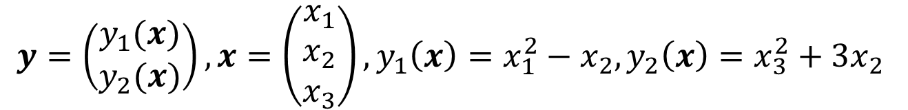
Pre-requisite
Matrix differentiation
Function is a vector and the variable is a vector
Example
$$y=\left(\begin{matrix}y_{1}(x) \\ y_{2}(x)\end{matrix}\right), x=\left(\begin{matrix}x_{1} \\ x_{2} \\ x_{3}\end{matrix}\right),y_{1}\left(x\right)=x_{1}^{2}−x_{2},y_{2}\left(x\right)=x_{3}^{2}+3x_{2}$$
$$\frac{dy^{T}}{dx}=\left(\begin{matrix}\frac{dy_{1}(x)}{dx_{1}} & \frac{dy_{2}(x)}{dx_{1}} \\ \frac{dy_{1}(x)}{dx_{2}} & \frac{dy_{2}(x)}{dx_{2}} \\ \frac{dy_{1}(x)}{dx_{3}} & \frac{dy_{2}(x)}{dx_{3}}\end{matrix}\right)=\left(\begin{matrix}2x_{1} & 0 \\ −1 & 3 \\ 0 & 2x_{3}\end{matrix}\right)$$

Slide 18
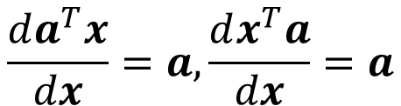

Pre-requisite
Useful results
$x,a∈ℝ^{n×1}$
Then
$$\frac{da^{T}x}{dx}=a,\frac{dx^{T}a}{dx}=a$$

Slide 19
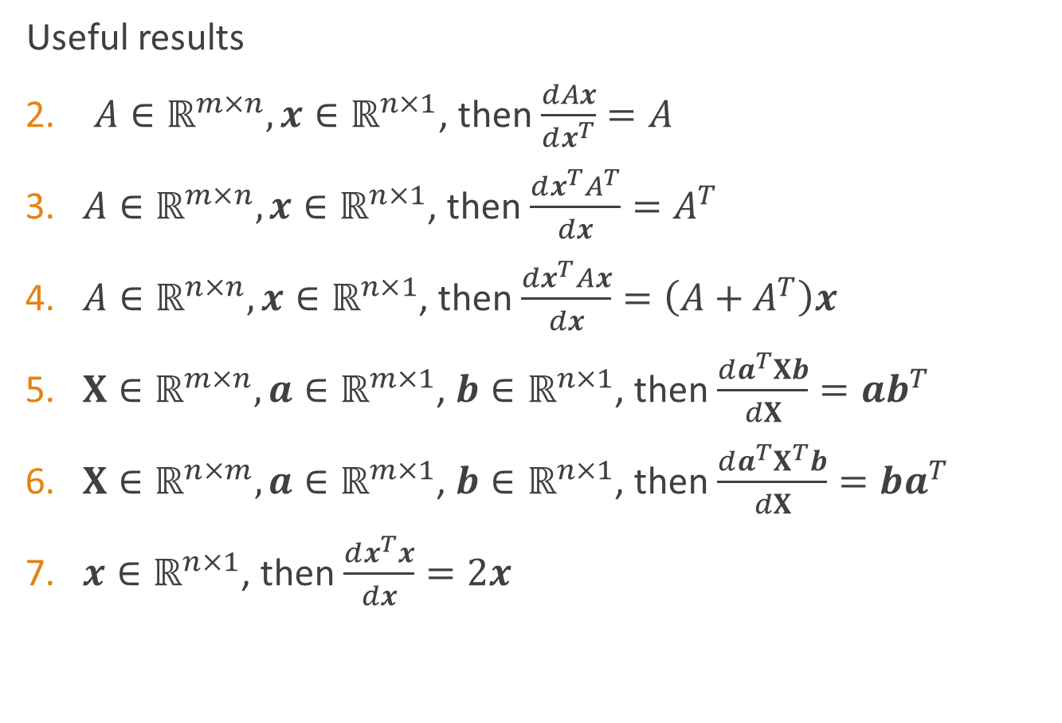
Pre-requisite
Useful results
$A∈ℝ^{m×n},x∈ℝ^{n×1}$, then $\frac{dAx}{dx^{T}}=A$
$A∈ℝ^{m×n},x∈ℝ^{n×1}$, then $\frac{dx^{T}A^{T}}{dx}=A^{T}$
$A∈ℝ^{n×n},x∈ℝ^{n×1}$, then $\frac{dx^{T}Ax}{dx}=\left(A+A^{T}\right)x$
$X∈ℝ^{m×n},a∈ℝ^{m×1}$, $b∈ℝ^{n×1}$, then $\frac{da^{T}Xb}{dX}=ab^{T}$
$X∈ℝ^{n×m},a∈ℝ^{m×1}$, $b∈ℝ^{n×1}$, then $\frac{da^{T}X^{T}b}{dX}=ba^{T}$
$x∈ℝ^{n×1}$, then $\frac{dx^{T}x}{dx}=2x$

Slide 20




Multivariate linear regression
Similarly,
${\hat{w}}^{∗}=\arg{\min_{\hat{w}}{{\left(y−X\hat{w}\right)}^{T}\left(y−X\hat{w}\right)}}$
$$E_{\hat{w}}$$
$$\frac{∂E_{\hat{w}} }{∂\hat{w}}=2X^{T}\left(X\hat{w}−y\right)$$
$=2X^{T}X\hat{w}−2X^{T}y$
$$=0$$
$$X^{T}X\hat{w}=X^{T}y$$

Slide 21




Multivariate linear regression
Discussion
If $X^{T}X$ is a full-rank matrix or a positive definite matrix,
Let ${\hat{x}}_{i}=\left(x_{i};1\right)$, then
If $X^{T}X$ is not a full-rank matrix
→ Inductive bias
$$X^{T}X\hat{w}=X^{T}y$$
$${\hat{w}}^{∗}={\left(X^{T}X\right)}^{−1}X^{T}y$$
$$f\left({\hat{x}}_{i}\right)={\hat{x}}_{i}^{T}{{\hat{w}}^{∗}}^{T}={{\hat{x}}_{i}^{T}\left(X^{T}X\right)}^{−1}X^{T}y$$

Slide 22
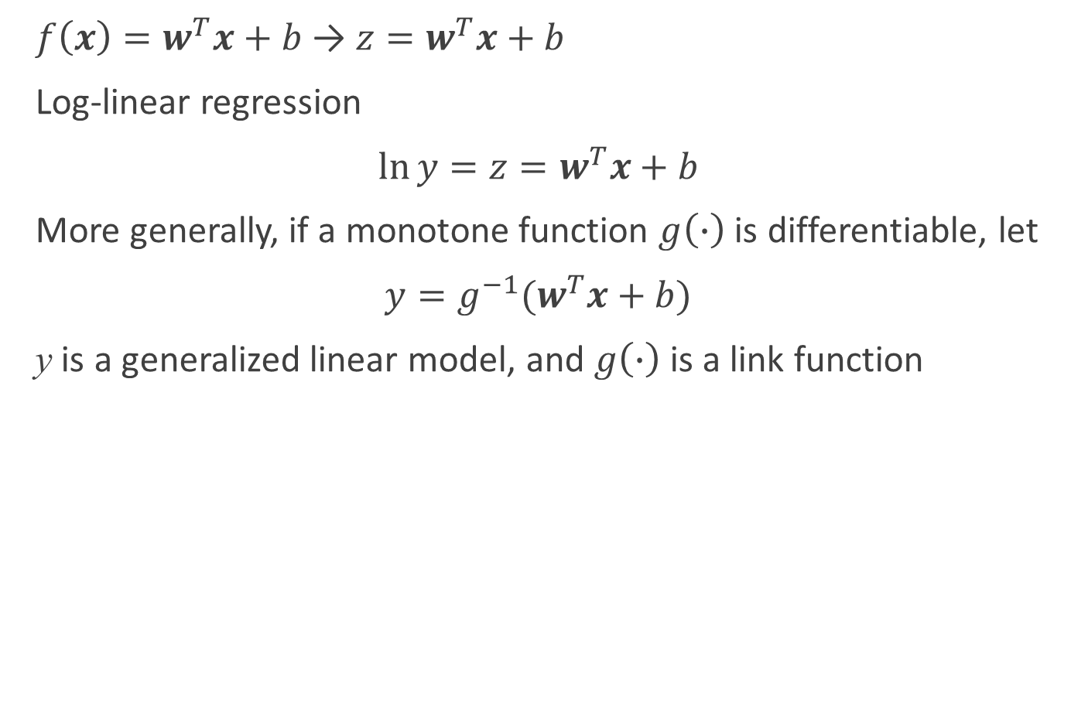
Generalized linear model
$f\left(x\right)=w^{T}x+b$ → $z=w^{T}x+b$
Log-linear regression
$\ln{y}=z=w^{T}x+b$
More generally, if a monotone function $g\left(∙\right)$ is differentiable, let
$y=g^{−1}(w^{T}x+b)$
y is a generalized linear model, and $g\left(∙\right)$ is a link function

Slide 23

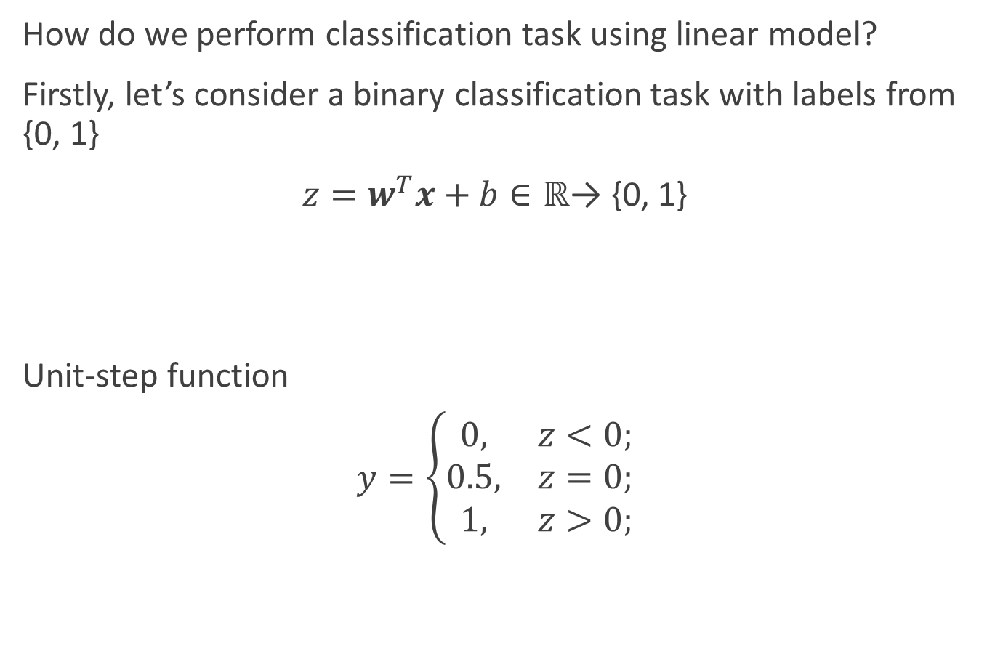
Logistic regression
How do we perform classification task using linear model?
Firstly, let’s consider a binary classification task with labels from {0, 1}
$z=w^{T}x+b∈ℝ$→ {0, 1}
Unit-step function
$y=\left\{\begin{matrix}0, & z<0; \\ 0.5, & z=0; \\ 1, & z>0;\end{matrix}\right.$

Slide 24
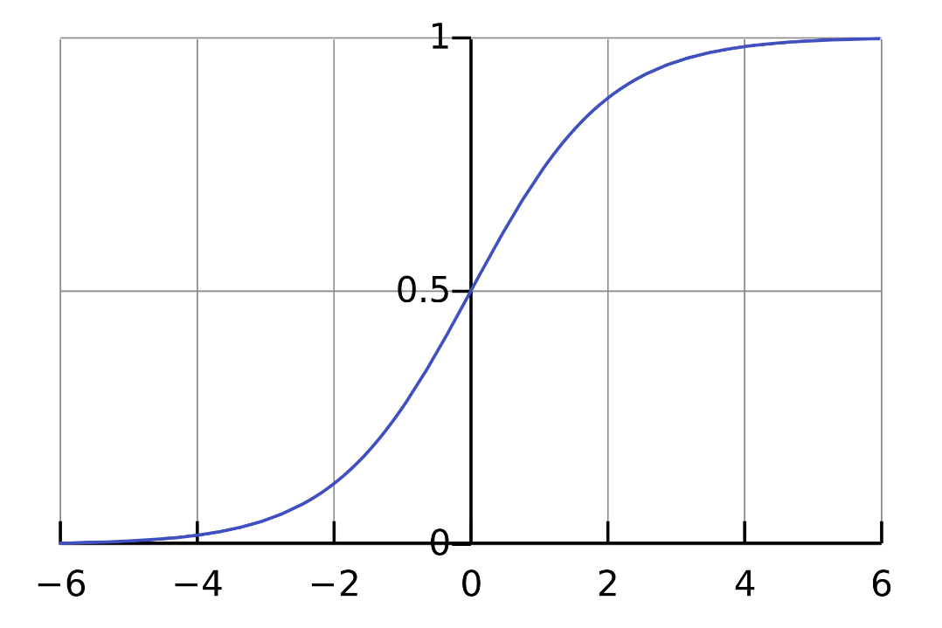

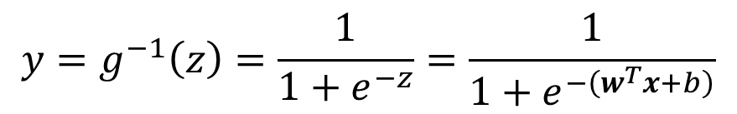
Logistic regression
But unit-step function is not continuous → cannot be used as $g^{−1}(⋅)$
So we have to find a “surrogate function”
Logistic function
$$y=g^{−1}\left(z\right)=\frac{1}{1+e^{−z}}=\frac{1}{1+e^{−\left(w^{T}x+b\right)}}$$

Slide 25
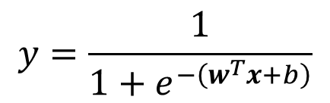
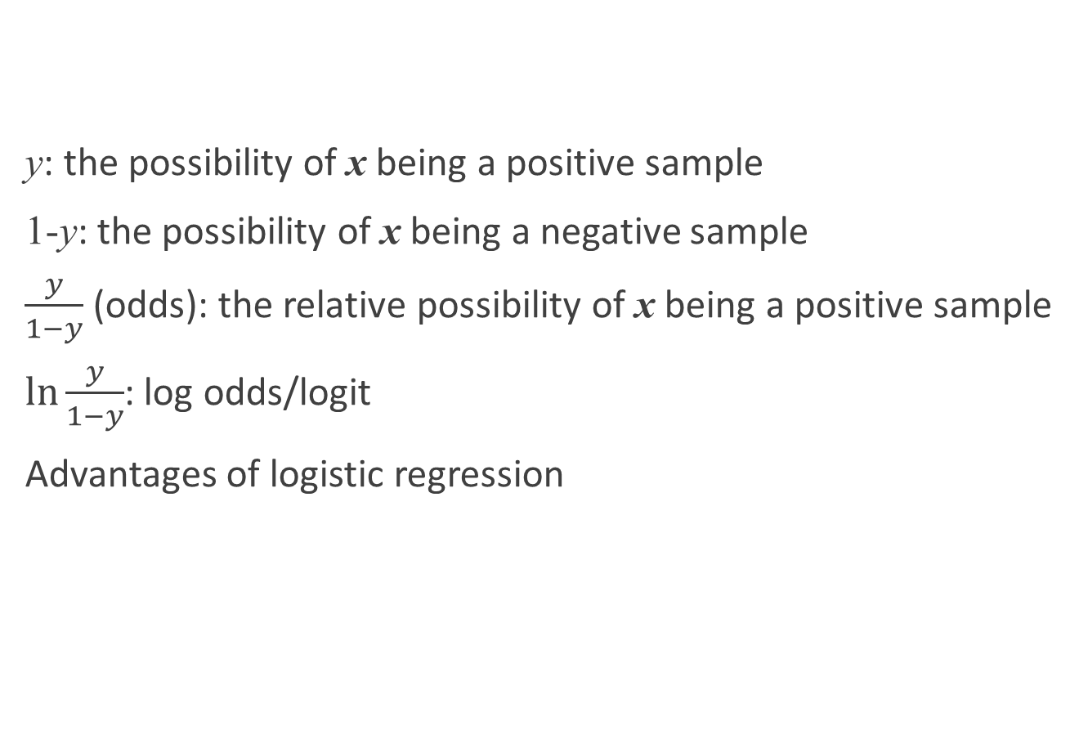
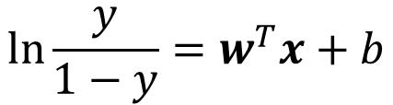
Logistic regression
y: the possibility of x being a positive sample
1-y: the possibility of x being a negative sample
$\frac{y}{1−y}$ (odds): the relative possibility of x being a positive sample
$\ln{\frac{y}{1−y}}$: log odds/logit
Advantages of logistic regression
$$y=\frac{1}{1+e^{−\left(w^{T}x+b\right)}}$$
$$ln\frac{y}{1−y}=w^{T}x+b$$

Slide 26
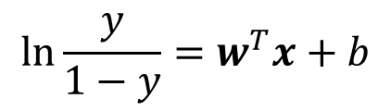

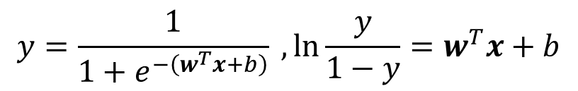


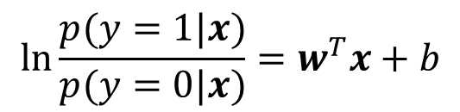
Logistic regression
Task: Determine w and b in
Solution:
Step 1. y → p ( y = 1 | x )
Step 2. Estimate w and b using maximum likelihood method
$$y=\frac{1}{1+e^{−\left(w^{T}x+b\right)}} ,ln\frac{y}{1−y}=w^{T}x+b$$
$$ln\frac{y}{1−y}=w^{T}x+b$$
$$ln\frac{p(y=1|x)}{p(y=0|x)}=w^{T}x+b$$
$$p\left(y=1 | x\right)=p_{1}(x)=\frac{e^{w^{T}x+b}}{1+e^{w^{T}x+b}}$$
$$p\left(y=0 | x\right)=p_{0}(x)=\frac{1}{1+e^{w^{T}x+b}}$$
$$p_{0}=1−p_{1}$$

Slide 27
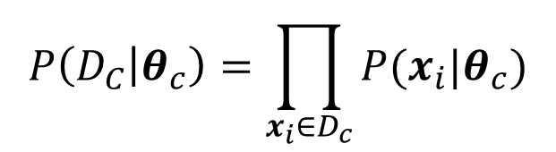
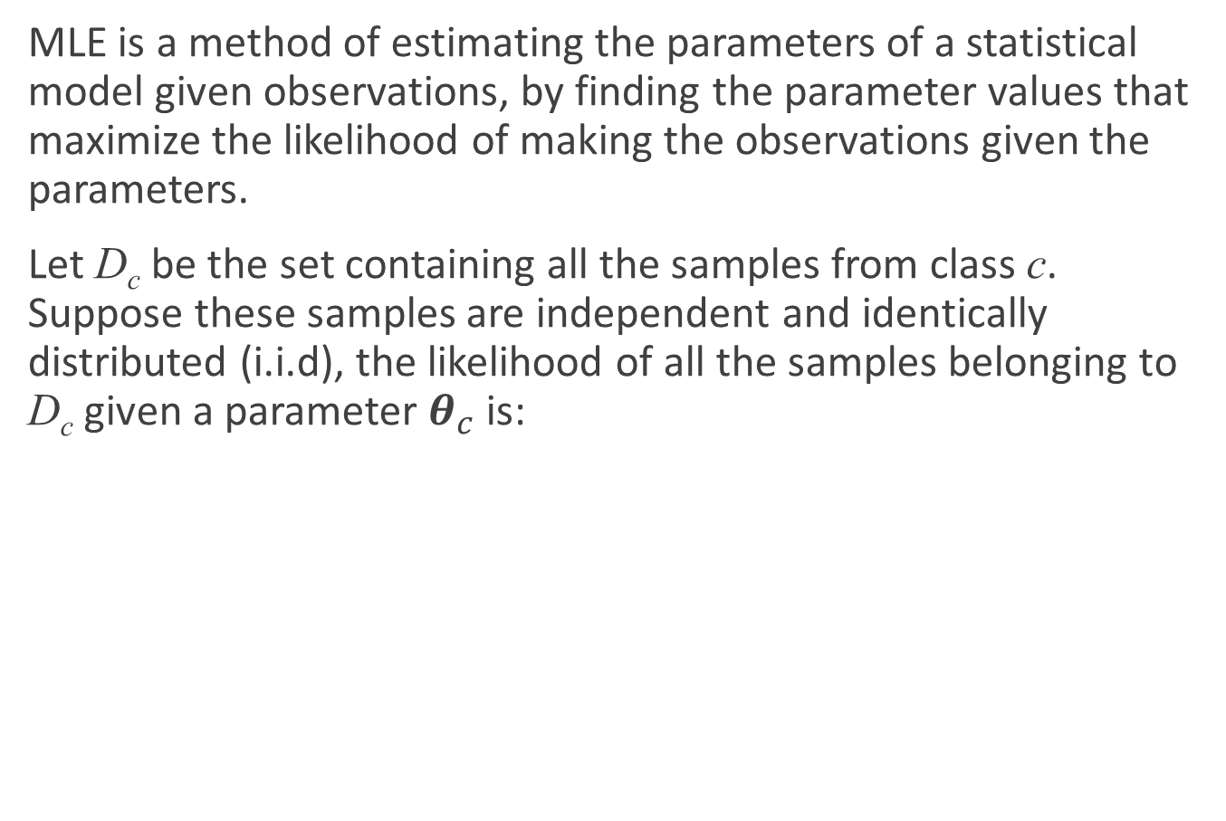
Pre-requisite: maximum likelihood estimation
MLE is a method of estimating the parameters of a statistical model given observations, by finding the parameter values that maximize the likelihood of making the observations given the parameters.
Let D_{c} be the set containing all the samples from class c. Suppose these samples are independent and identically distributed (i.i.d), the likelihood of all the samples belonging to D_{c} given a parameter $θ_{c}$ is:
$$P\left(D_{C} | θ_{c}\right)=\prod_{x_{i}∈D_{c}}{P(x_{i}|θ_{c})}$$

Slide 28



Pre-requisite: maximum likelihood estimation
We want to maximize $P(D_{C}|θ_{c})$
Log-likelihood ($LL(θ_{c})$) often used instead of using $P(D_{C}|θ_{c})$
The maximum likelihood estimation of $θ_{c}$ is
$$LL\left(θ_{c}\right)=\log{P\left(D_{C} | θ_{c}\right)}$$
$$=\sum_{x_{i}∈D_{c}}{\log{P(x_{i}|θ_{c})}}$$
$${\hat{θ}}_{c}=\arg{\max_{θ_{c}}{LL(θ_{c})}}$$

Slide 29


Pre-requisite: maximum likelihood estimation
Example:
If the probability density function $p\left(x | c\right)\sim 𝒩(μ_{c},Σ_{c})$, the MLE of $μ_{c}$and $Σ_{c}$is
$${\hat{μ}}_{c}=\frac{1}{\left|D_{c}\right|}\sum_{x_{i}∈D_{c}}{x_{i}}$$
$$Σ_{c}=\frac{1}{\left|D_{c}\right|}\sum_{x_{i}∈D_{c}}{\left(x_{i}−{\hat{μ}}_{c}\right){\left(x_{i}−{\hat{μ}}_{c}\right)}^{T}}$$

Slide 30
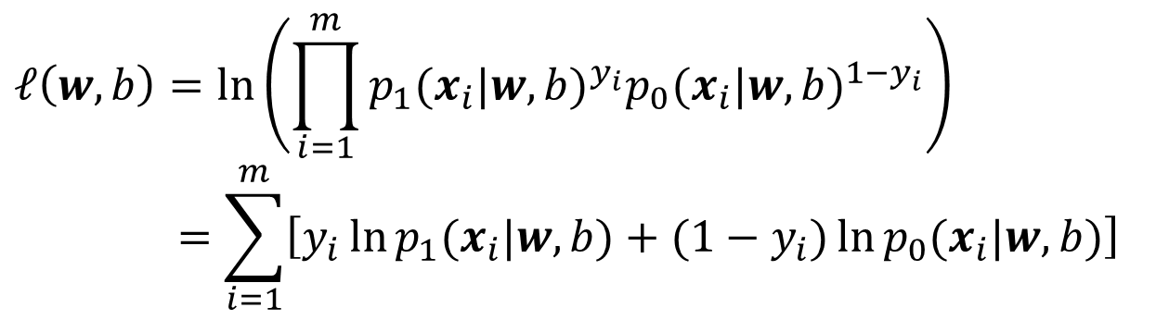

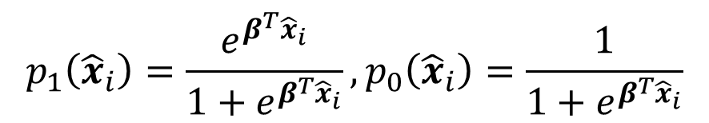
Logistic regression
Step 2. Estimate w and b using maximum likelihood method
Given a training set ${\left\{x_{i},y_{i}\right\}}_{i=1}^{m}$, the likelihood is then
Let $β=\left(w;b\right),\hat{x}=(x;1)$, then
$w^{T}x+b=β^{T}\hat{x}$
$$ℓ\left(w,b\right)=\ln\left(\prod_{i=1}^{m}{p_{1}{(x_{i}|w,b)}^{y_{i}}p_{0}{(x_{i}|w,b)}^{{1−y}_{i}}}\right)$$
$$=\sum_{i=1}^{m}{\left[y_{i}\ln{p_{1}(x_{i}|w,b)}+(1−y_{i})\ln{p_{0}(x_{i}|w,b)}\right]}$$
$$p_{1}\left({\hat{x}}_{i}\right)=\frac{e^{β^{T}{\hat{x}}_{i}}}{1+e^{β^{T}{\hat{x}}_{i}}},p_{0}\left({\hat{x}}_{i}\right)=\frac{1}{1+e^{β^{T}{\hat{x}}_{i}}}$$

Slide 31
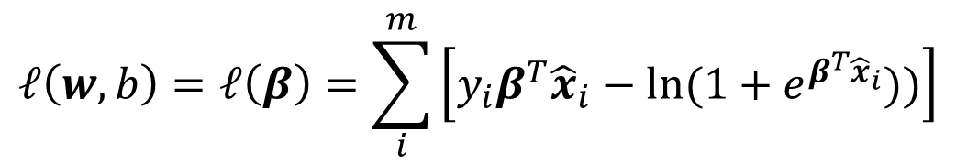
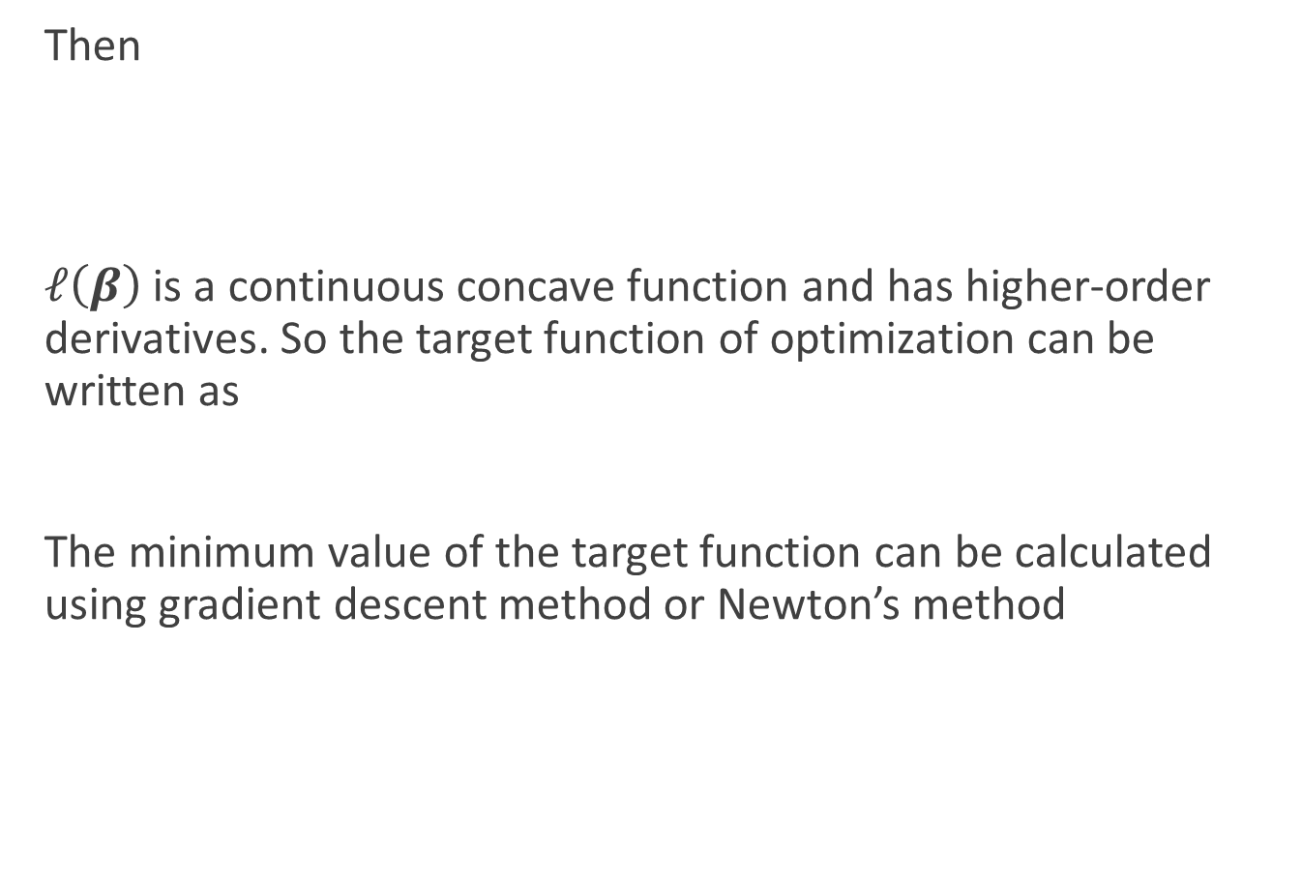
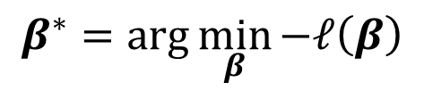
Logistic regression
Then
$ℓ\left(β\right)$ is a continuous concave function and has higher-order derivatives. So the target function of optimization can be written as
The minimum value of the target function can be calculated using gradient descent method or Newton’s method
$$ℓ\left(w,b\right)=ℓ\left(β\right)=\sum_{i}^{m}{\left[y_{i}β^{T}{\hat{x}}_{i}−ln⁡(1+e^{β^{T}{\hat{x}}_{i}}))\right]}$$
$$β^{∗}=\arg{\min_{β}{−ℓ\left(β\right)}}$$

Slide 32
Pre-requisite: Newton’s method
The name "Newton's method" is derived from Isaac Newton's description of a special case of the method in De analysi per aequationes numero terminorum infinitas (written in 1669, published in 1711 by William Jones) and in De metodis fluxionum et serierum infinitarum(written in 1671, translated and published as Method of Fluxions in 1736 by John Colson).
Newton’s method was first published in 1685 in A Treatise of Algebra both Historical and Practical by John Wallis.
In 1690, Joseph Raphson published a simplified description in Analysis aequationum universalis.

Slide 33



Pre-requisite: Newton’s method
In the one-dimensional problem, Newton's method attempts to find the roots of $f′$ by constructing a sequence $xn$ from an initial guess $x0$ that converges towards some value $x^{∗}$ satisfying $f^{′}\left(x^{∗}\right)=0$. This $x^{∗}$ is a stationary point of $f$.

Slide 34

Pre-requisite: Newton’s method
Consider
$\min{f(x)}$
The second-order Taylor expansion around $x_{0}$
Instead of $\min{f(x)}$, solve $\min{g(x)}$, i.e $g′\left(x\right)=0$
$f′\left(x_{0}\right)+f′′\left(x_{0}\right)Δx=0$
$⇒Δx=−\frac{f′\left(x_{0}\right)}{f′′\left(x_{0}\right)}$
The direction $d=−\frac{f′\left(x_{0}\right)}{f′′\left(x_{0}\right)}$ is the Newton direction
$$f\left(x\right)=f\left(x_{0}+Δx\right)≈f\left(x_{0}\right)+f^{′}\left(x_{0}\right)Δx+\frac{1}{2}f^{′′}\left(x_{0}\right)Δx^{2}≜g(x)$$

Slide 35

Pre-requisite: Newton’s method
The algorithm
Step 0 Given $x^{0}$, set $k := 0$.
Step 1 $d^{k}=−\frac{f′\left(x_{k}\right)}{f′′\left(x_{k}\right)}$, if $\left\|d^{k}\right\|≤ε$, then stop
Step 2 Set $x^{k+1}←x^{k}+d^{k}, k←k+1$, go to step 1

Slide 36


Pre-requisite: Newton’s method
The above iterative scheme can be generalized to several dimensions by replacing the derivative with the gradient, $∇f (x)$, and the reciprocal of the second derivative with the inverse of the Hessian matrix, $H\left[f\left(x\right)\right]$. One obtains the iterative scheme
Step 0 Given $x^{0}$, set $k := 0$.
Step 1 $d^{k}=−{\left(∇^{2}f\left(x^{k}\right)\right)}^{−1}∇f\left(x^{k}\right)$, if $\left\|d^{k}\right\|≤ε$, then stop
Step 2 Set $x^{k+1}←x^{k}+d^{k}, k←k+1$, go to step 1
$$H=\left[\begin{matrix}\frac{∂^{2}f}{∂x_{1}^{2}} & \frac{∂^{2}f}{∂x_{1}∂x_{2}} & \begin{matrix}⋯ & \frac{∂^{2}f}{∂x_{1}∂x_{n}}\end{matrix} \\ \begin{matrix}\frac{∂^{2}f}{∂x_{2}∂x_{1}} \\ ⋮\end{matrix} & \begin{matrix}\frac{∂^{2}f}{∂x_{2}^{2}} \\ ⋮\end{matrix} & \begin{matrix}\begin{matrix}⋯ & \frac{∂^{2}f}{∂x_{2}∂x_{n}}\end{matrix} \\ \begin{matrix}⋱ & ⋮\end{matrix} \end{matrix} \\ \frac{∂^{2}f}{∂x_{n}∂x_{1}} & \frac{∂^{2}f}{∂x_{n}∂x_{1}} & \begin{matrix}⋯ & \frac{∂^{2}f}{∂x_{n}^{2}} \end{matrix}\end{matrix}\right]$$

Slide 37



Logistic regression
Then
$−ℓ\left(β\right)$ is a continuous convex function and has higher-order derivatives. So the target function of optimization can be written as
The minimum value of the target function can be calculated using gradient descent method or Newton’s method
Using Newton’s method, in t+1 iteration,
$$−ℓ\left(w,b\right)=−ℓ\left(β\right)=\sum_{i}^{m}{−y_{i}β^{T}{\hat{x}}_{i}+ln⁡(1+e^{β^{T}{\hat{x}}_{i}}))}$$
$$β^{∗}=\arg{\min_{β}{−ℓ\left(β\right)}}$$
$$β^{t+1}=β^{T}−{\left(\frac{∂^{2}ℓ\left(β\right)}{∂β∂β^{T}}\right)}^{−1}\frac{∂ℓ\left(β\right)}{∂β}$$

Slide 38

Logistic regression
The first and second derivatives of are given in the book
Assignment 1:
Implement the logistic regression model using matlab (R, Python, or any language you are familiar)
You can use any dataset in UCI repository to validate your model
Select two attributes from the dataset and plot a figure like this →

Slide 39



Pre-requisite: Lagrange multiplier
Lagrange multiplier is a strategy for finding the local extremum of a function subject to equality constraints
Problem:
$\max{f(x)} or\min{−f(x)},x∈ℝ^{n×1}$
$s.t. g_{k}\left(x\right)=0, k=1,…m$

Slide 40



Pre-requisite: Lagrange multiplier
Solution:
If $\left(x_{0},λ_{10},λ_{20},…,λ_{m0}\right)$ is a stationary point of F, then $x_{0}$ is a stationary point of $f(x)$ with constraints
$\left(x_{0},λ_{10},λ_{20},…,λ_{m0}\right)$ is a stationary point of $F$
$$F\left(x;λ_{1},…,λ_{m}\right)=f\left(x\right)+\sum_{k}^{m}{λ_{k}g_{k}(x)}$$
$$\frac{dF}{dx_{1}}=0, \frac{dF}{dx_{2}}=0,…,\frac{dF}{dx_{n}}=0,\frac{dF}{dλ_{1}}=0,…,\frac{dF}{dλ_{m}}=0$$
n+m equations!

Slide 41





Pre-requisite: Lagrange multiplier
Example:
Problem: for a given point $p_{0}=(1,0)$, among all the points lying on the line $y=x$, identify the one having the least distance to $p_{0}$.
The distance is
$f\left(x,y\right)={\left(x−1\right)}^{2}+{\left(y−0\right)}^{2}$
Now we want to find the stationary point of $f\left(x,y\right)$ under the constraint $g\left(x,y\right)=y−x=0$
According to Lagrange multiplier method, construct another function
$$?$$
$$p_{0}$$
$$y=x$$
$$F\left(x,y,λ\right)=f\left(x,y\right)+λg\left(x,y\right)={\left(x−1\right)}^{2}+{\left(y−0\right)}^{2}+λ(y−x)$$

Slide 42




Pre-requisite: Lagrange multiplier
Example:
Problem: for a given point $p_{0}=(1,0)$, among all the points lying on the line $y=x$, identify the one having the least distance to $p_{0}$.
Find the stationary point for $F\left(x,y,λ\right)$
$$\left\{\begin{aligned}\frac{dF}{dx}=0 \\ \frac{dF}{dy}=0 \\ \frac{dF}{dλ}=0 \end{aligned}\right.$$
$$?$$
$$\left\{\begin{aligned}2\left(x−1\right)+λ=0 \\ 2y−λ=0 \\ x−y=0\end{aligned}\right.$$
$$p_{0}$$
$$y=x$$
$$\left\{\begin{aligned}x=0.5 \\ y=0.5 \\ λ=1\end{aligned}\right.$$

Slide 43



Linear discriminant analysis
In a two-class classification problem, given n samples in a d-dimensional feature space. There are n₁ samples belong to class 1 and n₂ samples belong to class 2.
Goal: to find a vector w, and project the n samples on the axis y = w^{T}x, so that the projected samples are well separated.
$$y=w_{1}^{T}x$$
$$y=w_{2}^{T}x$$

Slide 44



Linear discriminant analysis
Given a dataset $D={\left\{\left(x_{k},y_{k}\right)\right\}}_{k=1}^{m},y_{k}∈\left\{0,1\right\}$, denote $x_{j}^{i},μ_{i},Σ_{i}$ the samples, the sample mean vector, and the covariance matrix of class i, respectively.
The sample mean of the projected points in the i-th class is:
The variance of the projected points in the i-th class is
$${\tilde{μ}}_{i}=\frac{1}{n_{i}}\sum_{j=1}^{n_{i}}{w^{T}x_{j}^{i}}=w^{T}μ_{i}$$
$${\tilde{Σ}}_{i}=\sum_{j=1}^{n_{i}}{\left(w^{T}x_{j}^{i}−w^{T}μ_{i}\right){\left(w^{T}x_{j}^{i}−w^{T}μ_{i}\right)}^{T}}=w^{T}Σ_{i}w$$

Slide 45


Linear discriminant analysis
The between-class scatter matrix is:
$S_{b}=\left(μ_{0}−μ_{1}\right){\left(μ_{0}−μ_{1}\right)}^{T}$
The within-class scatter matrix is:
$S_{w}=Σ_{0}+Σ_{1}$
The fisher linear discriminant analysis will choose the w, which maximize:
i.e. the between-class distance should be as large as possible, meanwhile the within-class scatter should be as small as possible.
$$J\left(w\right)=\frac{{\left\|w^{T}μ_{0}−w^{T}μ_{1}\right\|}_{2}^{2}}{{\tilde{Σ}}_{0}+{\tilde{Σ}}_{1}}=\frac{w^{T}\left(μ_{0}−μ_{1}\right){\left(μ_{0}−μ_{1}\right)}^{T}w}{w^{T}Σ_{0}w+w^{T}Σ_{1}w}=\frac{w^{T}S_{b}w}{w^{T}S_{w}w}$$

Slide 46



Linear discriminant analysis
Without loss of generality, let $w^{T}S_{w}w=1$
The optimization problem can be rewritten as:
$\min_{w}{−w^{T}S_{b}w}$
$s.t. w^{T}S_{w}w=1.$
Using Lagrange multiplier method, we need to find the minimum of the following function:
$F\left(w,λ\right)=−w^{T}S_{b}w+λw^{T}S_{w}w−λ$
F(w) is a convex function
$$\frac{∂F}{∂w}=0$$
$$\frac{∂F}{∂λ}=0$$
$$S_{b}w=λS_{w}w$$

Slide 47

Linear discriminant analysis
Let $S_{b}w=\left(μ_{0}−μ_{1}\right){\left(μ_{0}−μ_{1}\right)}^{T}w=\left(μ_{0}−μ_{1}\right)λ′$, then
$S_{b}w=λS_{w}w$
$⇒S_{w}^{−1}S_{b}w=λw$
$⇒S_{w}^{−1}\left(μ_{0}−μ_{1}\right){\left(μ_{0}−μ_{1}\right)}^{T}w=S_{w}^{−1}\left(μ_{0}−μ_{1}\right)λ′=λw$
$⇒w=S_{w}^{−1}(μ_{0}−μ_{1})$
In practice, we compute the singular value decomposition of $S_{w}$, i.e. $S_{w}=UΣV^{T}$. Then $S_{w}^{−1}=VΣ^{−1}U^{T}$

Slide 48











































Multiclass classification
Binary classification $⇒$ multiclass classification
  One vs. One (OvO)
  One vs. Rest (OvR)
C₁
C₂
C₃
C₄
OvR
OvO
“+”
“-”
C₁
C₂
$$⇒$$
$$f_{1}$$
$$⟶$$
$$C_{1}$$
“+”
“-”
C₂
$$⟶$$
$$⇒$$
$$f_{2}$$
$$⟶$$
$$C_{3}$$
C₁
C₃
C₄
$$⇒$$
$$f_{1}$$
“-”
C₁
C₃
C₁
$$f_{2}$$
$$⟶$$
“-”
C₁
C₄
$$⇒$$
$$f_{3}$$
$$⟶$$
$$C_{1}$$
C₂
C₃
C₄
$$⇒$$
$$⟶$$
$$C_{3}$$
$$⟶$$
$$C_{3}$$
C₁
C₂
C₃
$$⇒$$
$$f_{4}$$
$$⟶$$
$$C_{3}$$
C₃
C₂
C₄
$$⇒$$
$$f_{3}$$
$$⟶$$
“+”
$$⇒$$
$$⟶$$
C₁
$$⇒$$
$$⟶$$
C₂
C₄
$$f_{5}$$
$$C_{2}$$
C₄
C₂
C₃
$$f_{4}$$
“-”
C₃
C₄
$$⇒$$
$$f_{6}$$
$$⟶$$
$$C_{3}$$
N(N-1)/2 classifiers

Slide 49







Multiclass classification
Binary classification $⇒$ multiclass classification
  Many vs. Many (MvM)
Error correcting output codes
Encode
Decode
Hamming
distance
Euclidian
distance
$$f_{1} f_{2} f_{3} f_{4} f_{5}$$
$$C_{1}$$
$$C_{2}$$
$$C_{3}$$
$$C_{4}$$
-1 | +1 | -1 | +1 | +1
+1 | -1 | -1 | +1 | -1
-1 | +1 | +1 | -1 | +1
-1 | -1 | +1 | +1 | -1
$$3 2\sqrt{3}$$
$$4 4$$
$$1 2$$
$$2 2\sqrt{2}$$
test sample
-1 | -1 | +1 | -1 | +1

Slide 50


Class-imbalance
In previous problems, it is assumed that the numbers of samples from different classes are about the same.
However, if the samples from different classes are heavily imbalanced, the learning process will be greatly influenced.
  E.g. 998 negatives vs. 2 positives
Consider class-imbalance when using logistic regression to perform a classification task
When # of positives and negatives are the same:
  $y>0.5 or\frac{y}{1−y}>1$: positive
  $y<0.5 or\frac{y}{1−y}<1$: negative
$$\ln{\frac{y}{1−y}}=w^{T}x+b$$

Slide 51


Class-imbalance
However, when # of positives and negatives are not equal, let $m^{+}$ be the number of positives and $m^{−}$ be the number of negatives
The odds of observing a positive is $\frac{m^{+}}{m^{−}}$
Therefore, the classification criteria is
  $\frac{y}{1−y}>\frac{m^{+}}{m^{−}}$: positive
  $\frac{y}{1−y}<\frac{m^{+}}{m^{−}}$: negative
Rescaling
$$\frac{y′}{1−y′}=\frac{y}{1−y}×\frac{m^{−}}{m^{+}}$$

Slide 52
Class-imbalance
Undersampling
  EasyEnsemble [Liu et al., 2009]
Oversampling
  SMOTE [Chawla et al., 2002]
Threshold-moving

